Slide 1


The Future…
Magnus Gudmundsson CyberDaDa,
Christoffer Noring, Softhouse

Slide 2
Angular 2
TypeScript
Ecmascript 6
Aurelia

Slide 3
The future started yesterday
and we are already late...

Slide 4
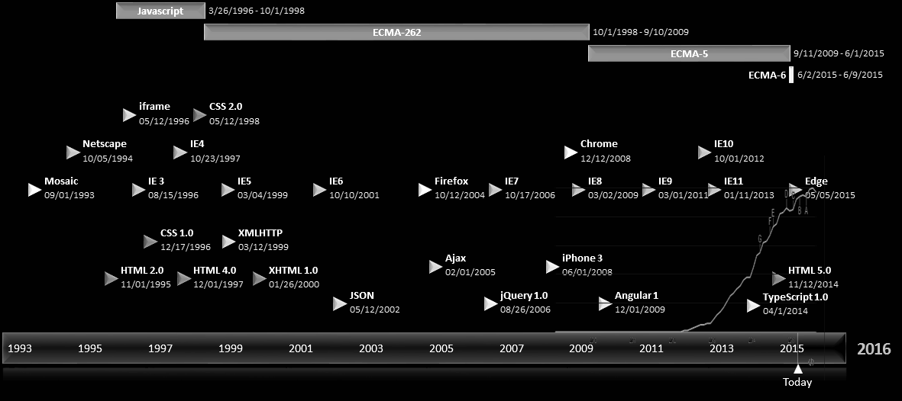

Slide 5
A framework that cannot work with Web Components, bogs down on mobile or continues to push its own module and class API against the standards,
is not going to last long.
The Angular team's answer to these problems is a new version: Angular 2.0.
It is essentially a re-imagining of AngularJS for the modern web, taking into account everything that has been learned over the last five years.
http://eisenbergeffect.bluespire.com/all-about-angular-2-0/
Notes:
Angular 1.x has started in 2009, so it is not so fresh anymore and it is criticized more and more, mostly for the features that made the framework so popular.
Two way data binding looks great at first sight, but it introduces coupling: everything can update everything. This makes debugging and tracking errors really difficult. In addition, the performance of the applications drops significantly with growing number of objects on the pages.
Directives are great, but have you tried to understand its API? How much time did you need to master directives? Restrict, isolating the scope, link (pre-link, post-link), compile, transclusion, directive communication (and more) makes developers really suffer.

Slide 6
Goals:
The Fastest JS Framework available → Benchpress
Fast and Smooth →
Webworkers (but webworkers do not have access to DOM)
Mobile first
Because rendering is already separated, possibilty to build
separate renderers for IOS /android etc, and thus escape the webview...
Simpler syntax.
Modular. Almost every piece of AngularJS should be optional, replaceable, and even used in other non-AngularJS frameworks.
Server side Rendering
Compile as build step. Angular apps parse and compile their HTML templates. initial rendering to be speeded up by moving the compile step into the build process.

Slide 7


Slide 8
Hello Angular 2 world
The second system effect…. you go from something that was fit for purpose, but a little bit ugly to ...

Slide 9

/// <reference path="typings/angular2/angular2.d.ts" />
import {Component, View, bootstrap} from 'angular2/angular2';
// Annotation section
@Component({
selector: 'my-app'
})
@View({
template: '<h1>Hello {{name}}</h1>'
})
// Component controller
class MyAppComponent {
name: string;
constructor() {
this.name = 'World';
}
}
bootstrap(MyAppComponent);

Slide 10

TypeScript
ES6
JS (ES5)
Anders Hejlsberg
TypeScript is a syntactic sugar for JavaScript. “Javascript with types...”
TypeScript syntax is a superset of Ecmascript 5 (ES5) syntax.
Every JavaScript program is also a TypeScript program.
TypeScript optionally provides source maps, enabling source-level debugging.
TypeScript tools typically emit JavaScript upon file save, preserving the test, edit, refresh cycle commonly used in JavaScript development.
AKA Mr Turbo Pascal AKA Mr Delphi AKA Mr J++ AKA Mr C# AKA Mr TypeScript

Slide 11
TypeScript syntax includes several proposed features of Ecmascript 6 (ES6), including classes, modules and the fat arrow. => + type checking, interfaces, generics, enums and decorators
TypeScript classes seem to be pretty straight-forward. Very similar to ES6 classes. But there are a few key points:
Same as ES6, class members are marked static.
All members are public by default.
Members can be marked as private. This is enforced at the compiler level, not in the output JavaScript source.
Constructor arguments can be put straight onto the instance by explicitly marking them as public.

Slide 12
/// <reference path="typings/angular2/angular2.d.ts" />
import {Component, View, bootstrap} from 'angular2/angular2';
// Annotation section
@Component({
selector: 'my-app'
})
@View({
template: '<h1>Hello {{name}}</h1>'
})
// Component controller
class MyAppComponent {
name: string;
constructor() {
this.name = 'World';
}
}
bootstrap(MyAppComponent);
Component : Metadata about the component -->name of selector, properties, events , dependencies on other components etc.
View: Html template(s) + Style templates. Can be uris. Also list of all directives used in the template(if any)
<html>
<head>
<title>Angular 2 Hello Worldy</title>
<script src="http://libs/traceur.js"></script>
<script src="http://libs/system@0.16.js"></script>
<script src="https://libs/angular2.dev.js"></script>
</head>
<body>
<my-app></my-app>
<script>System.import('app');</script>
</body>
</html>

Slide 13
/// <reference path="typings/angular2/angular2.d.ts" />
import {Component, View, bootstrap} from 'angular2/angular2';
// Annotation section
@Component({
selector: 'my-app'
})
@View({
template: '<h1>Hello {{name}}</h1>'
})
// Component controller
class MyAppComponent {
name: string;
constructor() {
this.name = 'World';
}
}
bootstrap(MyAppComponent);
First, what do we need to actually use a directive? a selector. In Angular 1 we had the restrict property. in Angular 2 we can use:
foo: that will restrict for an element.
[foo]: that will restrict for an attribute.
.class: that will restrict for a class.
input[type=text]: that will apply this directive only in <input type="text">

Slide 14
Properties - Angular 2
<img [src]="myImage">
The directives that we used in angular 1 for interpolation are gone. Instead we now put square brackets around the property.
<div [tooltip]="foo">...</div>
That won’t pass foo as the text, it will pass the content of this.foo as the text.

Slide 15
Events - Angular 2
Angular 2 introduces a new syntax events, also called statements:
<my-directive (select)="user.name(name)"></my-directive>
If it were a property, we would have: <my-directive [select]="user.name(name)"></my-directive> Now we can get rid of unneeded directives like ng-click, ng-blur, ng-change etc. <my-directive (click)="doSomething()"></my-directive> This will use the click event of the DOM, no more wrappers around that. click could be a custom event name as well. So (click) is the same as (skip) or (foo). The () symbols tell Angular that it's an event expression.

Slide 16
Tooltip Directive - Angular 2
Usage - notice the import.
@Directive({
selector: '[tooltip]',
properties: [
'text: tooltip'
],
hostListeners: {
'onmouseenter': 'onMouseEnter()',
'onmouseleave': 'onMouseLeave()'
}
})
class Tooltip{
text:string;
overlay:Overlay; // NOT YET IMPLEMENTED
overlayManager:OverlayManager; // NOT YET IMPLEMENTED
constructor(overlayManager:OverlayManager) {
this.overlay = overlay;
}
onMouseEnter() {
// exact signature to be determined
this.overlay = this.overlayManager.open(text, ...);
}
onMouseLeave() {
this.overlay.close();
this.overlay = null;
}
}
import {Tooltip} from 'tooltip';
@Component({
selector: 'my-component'
})
@View({
template: `<div tooltip="foo">Hello, {{message}}</div>`,
directives: [Tooltip]
})
class MyComponent {
constructor() {
this.message = 'World';
}
}

Slide 17
Refence - Angular 2
<p (click)="user.focus()">
Grab focus
</p>
<input type="text" #user (keyup)="x">
{{user.value}}

Slide 18
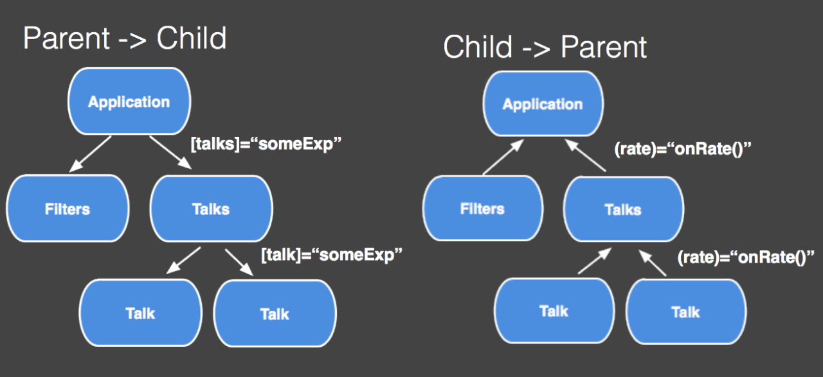
An Angular 2 Application is essentialy a Component tree.
Data flows into a component via property bindings, through square brackets.
Data flows out of a component via event bindings, through parenthesis.

Slide 19
COMPONENTS
A component knows how to interact with its host element.
A component knows how to render itself, so it knows its view.
A component configures dependency injection.
A component has a well-defined public API of property and event bindings.
Components in Angular 2 are self-describing. Their annotations contain all the information needed to instantiate them.
Any component can be bootstrapped as an application. It does not have to be special in any way. Moreover, any component can be loaded into a router outlet. As a result, you can write a component that can be bootstrapped as an application, loaded as a route, or used in some other component directly. This results in less API to learn. And it also makes components more reusable

Slide 20
Services - Angular 2
Definition
class TimeService{
getTime() {
return fetch('https://api.github.com/time).then(function(response) {
return response.json();
});
}
}
Usage
import {TimeService} from '../services/TimeService';
@Component({
viewInjector: [TimeService],
selector: 'clock'
})
@View({templateUrl: './clock.html'})
class Clock {
constructor (timeService: TimeService) {
this.time = timeService.getTime();
}
}

Slide 21
Some simple examples

Slide 22
ng-upgrade
You can mix Angular 1 and Angular 2 components in the same view.
Angular 1 and Angular 2 can inject services across frameworks.
Data binding works across frameworks.

